Slide 1
Introduction: Real-Time Vault System
Vault systems are examples of structures that are designed to secure and protect valuable assets and confidential information.
Can be in a physical form or digital form or an integration of both
Vaults are fortified enclosures with reinforced doors that are protected with an access system, which can be in the form of keypads, biometrics, RFID, and many more.

Slide 2
Objectives
To demonstrate how a real-time vault system works.
To be able apply what you have learned in logic circuits and switching theory, microprocessors, and CPE160P.
To be able to apply real-time embedded system using Arduino kit.

Slide 3
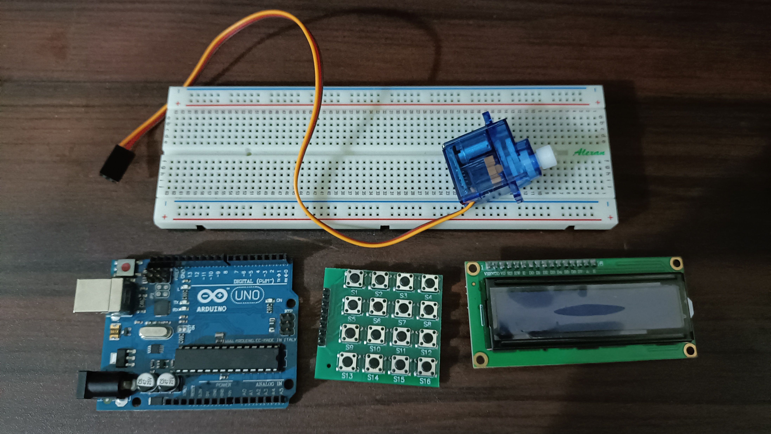
Materials
Hardware
Arduino Uno
4x4 Matrix Keypad
Liquid Crystal Display
Servo Motor
Notes:
The materials utilized to construct the real-time basketball scoreboard are the Arduino UNO, the 4-digit seven segment display, and 5 switch buttons.

Slide 4
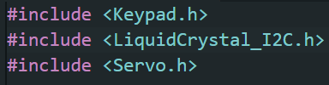
Materials
Software Libraries
Keypad.h
LiquidCrystal_I2C.h
Servo.h

Slide 5
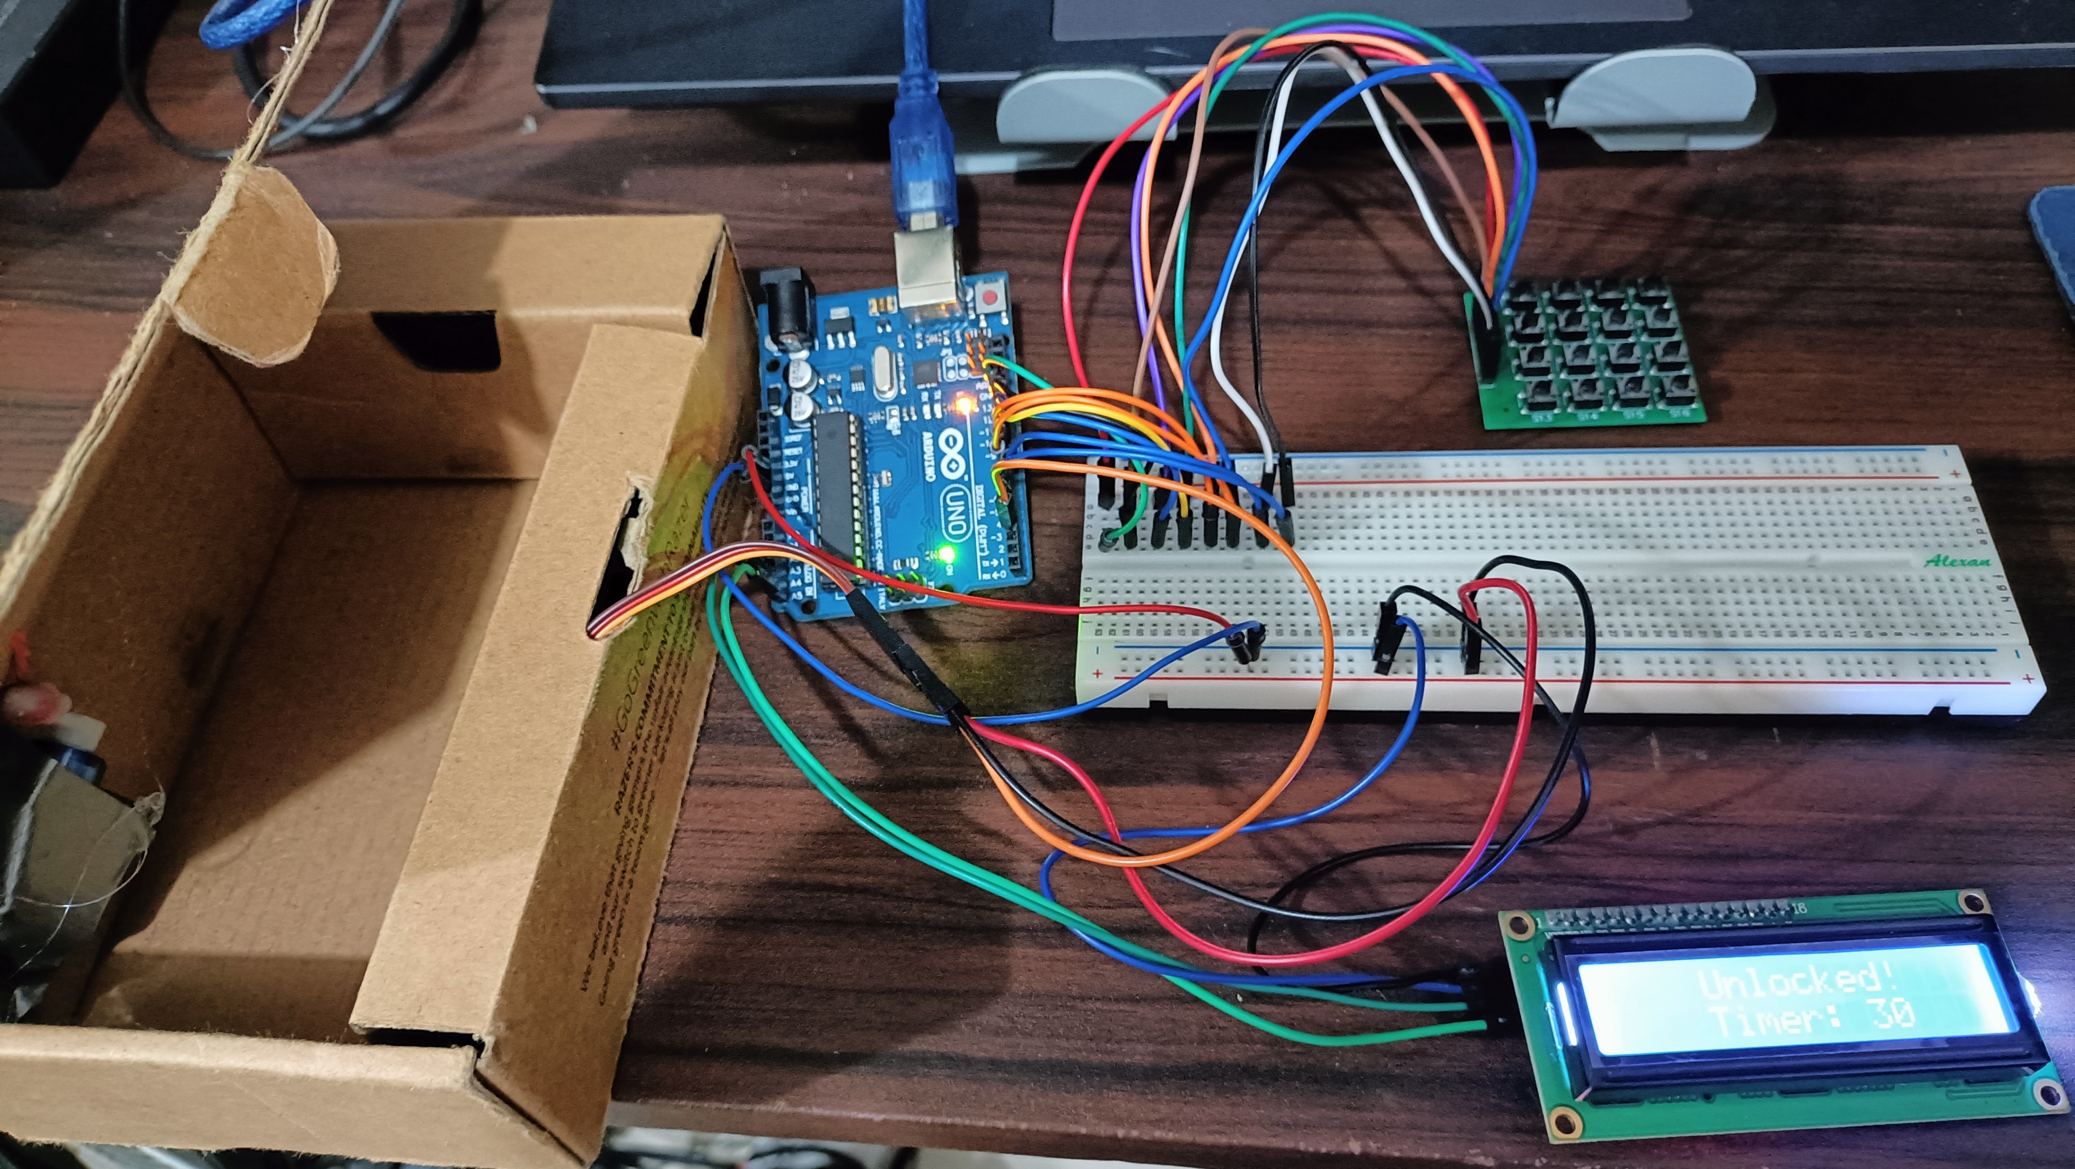
Discussion: Real-Time Vault System
A set 6-digit password should be the input of the user in order to open the vault for 20 seconds.
A button may also be pressed so that the time would be increased by 10 seconds.
An "Unlocked" and "Incorrect" statuses can be seen, depending on the input of the user.

Slide 6
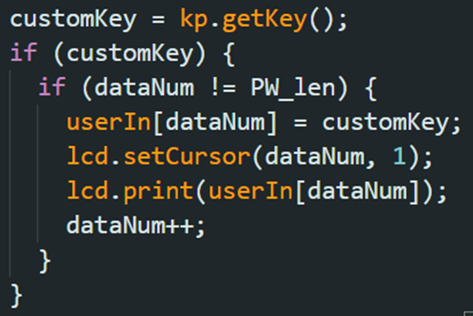
Discussion: Real-Time Vault System
The user input was made into an array so that the series of numbers will be stored individually and concatenated at the end.
If the data input is already equal with the length of the password, you can no longer input numbers.

Slide 7
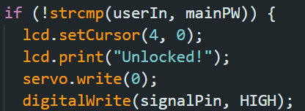
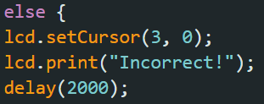
Discussion: Real-Time Vault System
the "#" symbol will be the ENTER key
Using strcmp, the set password will be compared with the user input
If the result is 0, the vault will be unlocked, so, the lcd prints "Unlocked" and the servo motor moves to angle 0 to open the vault
If the result is not 0, the vault will remain locked.

Slide 8
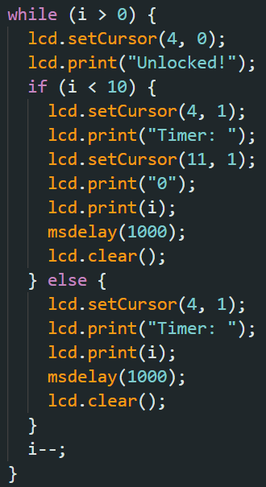
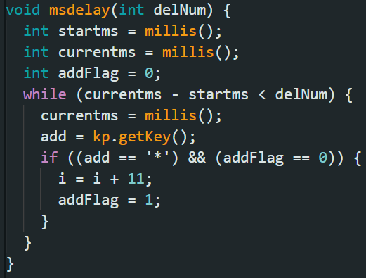
Discussion: Self-Driving Car
For the timer, a while loop was used
The i counts down and the LCD continues to print the value of the timer and the word unlocked
If the "*" was pressed while counting down, the value of i will be increased by 10 to extend the time that the vault is open

Slide 9
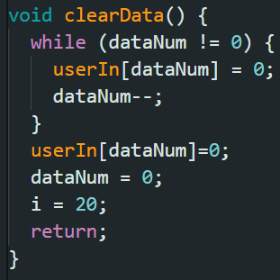
Discussion: Self-Driving Car
All of the characters inside the userIn array will be removed to reset the program, the value of i will be back to 20 and dataNum is also set to 0.

Slide 10
Conclusion
The real-time vault system works through:
  the input of the user in the keypad
  the comparing of the input and the set password, which can be seen on the LCD, along with the timer and status
  the opening and closing of the vault by the servo motor

Slide 11
Conclusion
The second objective was achieved by synchronizing the keypad with the LCD and servo motor, demonstrating the usage of microprocessors, logic circuits, switching theory, and CPE160P lessons
The real-time vault system was successfully built using the Arduino kit, and basic handshaking was shown by having synchronization in the input and output in real time.

Slide 12
Creation of the Experiment

